Slide 1



Blockchain Technology
Swapnadeep Mishra
Roll No: 002211001115
Department of Information Technology
Notes:
1

Slide 2

What is Blockchain?
Blockchain is a revolutionary shared, immutable digital ledger that records transactions across a distributed network with unprecedented security and transparency. Unlike traditional databases controlled by a single entity, blockchain operates as a decentralized system where information is stored across multiple nodes.
At its core, blockchain consists of data stored in linked blocks, each containing transaction information and cryptographic hashes that connect it to the previous block. This creates an unbreakable chain of records that cannot be altered without detection, making it ideal for applications requiring trust and verification.
The technology eliminates the need for intermediaries, reduces fraud, and provides a transparent audit trail that all authorized participants can access and verify in real-time.
Notes:
2

Slide 3

How Blockchain Works: Step-by-Step
Understanding the blockchain process reveals the elegance of its distributed consensus mechanism. Every transaction follows a precise validation pathway that ensures security and integrity across the network.
Initiate Transaction
Create Block
Network Consensus
Cryptographic Verify
01
02
03
Transaction Initiated
Block Creation
Network Validation
A user requests a transaction, which is broadcast to all nodes in the peer-to-peer network for processing.
Transactions are grouped together into a new block containing timestamp, transaction data, and cryptographic information.
Network nodes validate the transaction using consensus algorithms like Proof of Work or Proof of Stake.
04
05
Block Added to Chain
Transaction Complete
Once validated, the block is cryptographically linked to the previous block and permanently added to the blockchain.
The transaction is now complete and immutable, visible to all authorized participants in the network.
Notes:
3

Slide 4
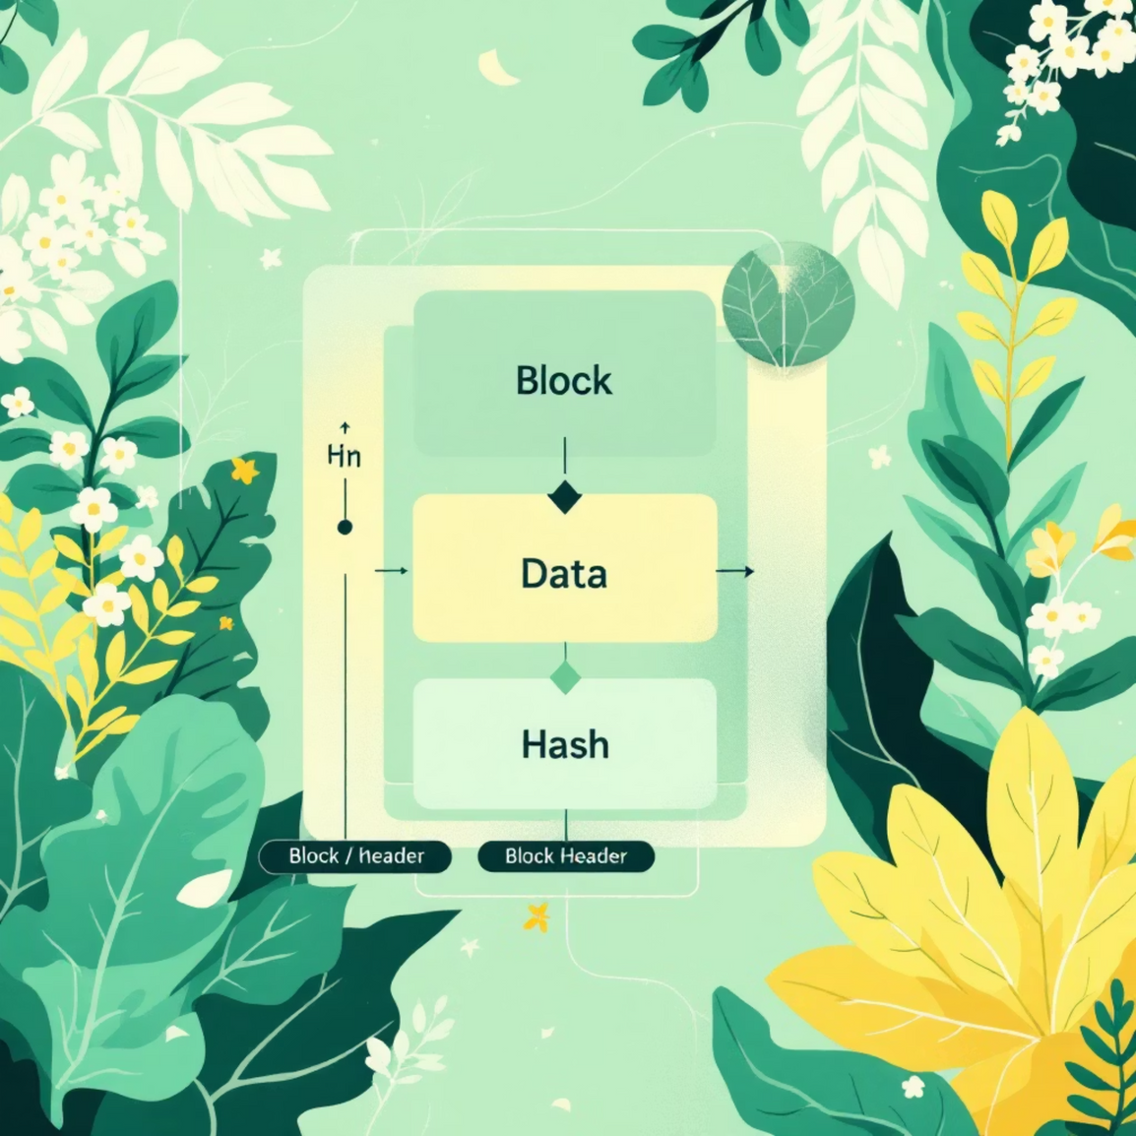
Block Structure Explained
Each block in a blockchain is a sophisticated data structure designed for security and integrity. Understanding its components reveals why blockchain is virtually tamper-proof.
Block Header
Contains metadata including timestamp, block version, and difficulty target for mining operations.
Transaction Data
The actual list of transactions being recorded, validated, and permanently stored in this block.
Current Hash
A unique cryptographic fingerprint generated from all the block's contents using SHA-256 algorithm.
Previous Hash
Links to the prior block's hash, creating the chain and ensuring any tampering is immediately detected.
Nonce
A random number used in mining to generate a valid hash meeting the network's difficulty requirements.
Notes:
4

Slide 5
Decentralization & Distributed Ledger
The revolutionary power of blockchain lies in its decentralized architecture, which fundamentally transforms how we think about data ownership and trust. Unlike traditional centralized systems where a single authority controls information, blockchain distributes identical copies of the ledger across thousands of nodes worldwide.
Centralized Network
Decentralized Network
Distributed Network
Traditional model with single point of control and failure. All data flows through one authority.
Multiple authorities share control. Reduced single points of failure but still some centralization.
Blockchain's model: no central authority, peer-to-peer validation, maximum resilience and transparency.
This distributed consensus mechanism means that altering any record would require simultaneously compromising the majority of network nodes—a practically impossible feat that makes blockchain exceptionally secure and trustworthy.
Notes:
5

Slide 6





Key Benefits of Blockchain
Blockchain technology delivers transformative advantages that address fundamental challenges in digital trust, efficiency, and security across industries.
Enhanced Security
Cryptographic encryption and distributed consensus mechanisms create an virtually impenetrable defense against fraud, hacking, and unauthorized modifications.
Complete Transparency
All network participants can view the entire transaction history, creating unprecedented accountability and trust in the system.
Immutable Records
Once data is recorded and validated, it becomes permanent and tamper-proof, providing a reliable audit trail for compliance and verification.
Operational Efficiency
Eliminates intermediaries and automates verification processes, dramatically reducing transaction times from days to minutes while cutting costs.
Notes:
6

Slide 7

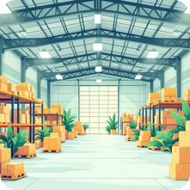




Blockchain Applications Across Industries
Blockchain's versatility extends far beyond cryptocurrency, revolutionizing operations across diverse sectors with enhanced security, transparency, and efficiency.
Finance & Banking
Supply Chain Management
Healthcare Systems
Digital Marketing
Facilitates real-time payments, cryptocurrency transactions, and automated smart contracts, removing intermediaries.
Provides end-to-end product tracking for transparency, reducing counterfeits and verifying authenticity.
Enables secure and private sharing of patient records across providers, ensuring critical information access.
Reduces ad fraud, transparently tracks performance, and verifies engagement for improved ROI.
Real Estate
Voting Systems
Streamlines property transactions, ensures transparent title records, and automates transfers with smart contracts.
Offers tamper-proof, transparent electronic voting, ensuring security and voter anonymity.
Notes:
7

Slide 8




Types of Blockchain Networks
Different blockchain architectures serve distinct purposes, each offering unique advantages for specific use cases and organizational requirements.
Consortium
Public
Private
Public Blockchain
Private Blockchain
Consortium Blockchain
Open to Everyone
Restricted Access
Semi-Decentralized
Decentralized & transparent
Controlled by single organization
Governed by group of orgs
Anyone can join, validate, view
Invitation-only participation
Hybrid public/private features
Examples: Bitcoin, Ethereum
Examples: Hyperledger, R3 Corda
Examples: Energy Web, IBM Food
Notes:
8

Slide 9

Challenges and Considerations
Despite its transformative potential, blockchain technology faces several significant obstacles that must be addressed for widespread adoption and optimal performance.
Scalability Limitations
Current blockchain networks process 7-15 transactions per second (Bitcoin), compared to Visa's 24,000 TPS. Network congestion leads to slower processing and higher fees during peak demand.
Energy Consumption
Proof-of-work mining consumes massive amounts of electricity. Bitcoin alone uses more energy annually than some countries, raising sustainability concerns.
Regulatory Uncertainty
Evolving legal frameworks create compliance challenges. Different jurisdictions have conflicting regulations regarding cryptocurrency and blockchain applications.
Adoption Barriers
Technical complexity, integration costs, and resistance to change slow enterprise adoption. Lack of standardization creates interoperability issues.
Looking Forward: Next-generation solutions like Ethereum 2.0's Proof-of-Stake, Layer-2 scaling solutions, and improved consensus algorithms are actively addressing these challenges to make blockchain more efficient and accessible.
Notes:
9

Slide 10



The Future of Blockchain
Blockchain technology stands at the threshold of mainstream adoption, poised to reshape how we interact with digital systems, conduct business, and establish trust in the decentralized future.
Web3 Integration
Enterprise & Government Adoption
Continuous Innovation
Seamless integration with decentralized applications (dApps), enabling user-owned data, decentralized finance (DeFi), and new economic models built on trustless protocols.
Growing implementation in supply chains, identity management, and public services. Governments exploring central bank digital currencies (CBDCs) and blockchain-based governance.
Revolutionary consensus mechanisms, quantum-resistant cryptography, and cross-chain interoperability solutions driving scalability and sustainability improvements.
Embrace Blockchain Knowledge for Tomorrow's Tech Landscape
The blockchain revolution is not just about technology—it's about reimagining trust, transparency, and collaboration in the digital age. As future IT professionals, understanding blockchain fundamentals positions us to lead innovation and drive transformation across industries.
Notes:
10

Slide 11
Thank You
Notes:
11

